Slide 1
Realistic Bokeh Effect using a Generative Modeling Approach
Presented by,
Shilpa Singh, Sourabh Gothe
11/12/2022

Slide 2

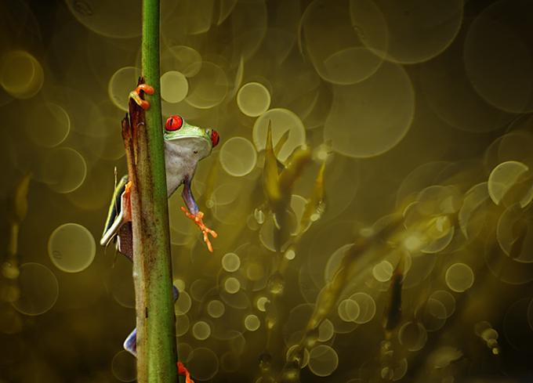


Motivation
Bokeh effect photography often results in clear in-focus elements and blur out-of-focus regions. This type of appearance can be rendered naturally by DSLR with ease.
Smartphones, on the other hand, lack in directly capturing photographs with depth-of-field effects due to tiny lenses and sensors. Although high end phones enable us to take photos with shallow depth of field.
This project aims to estimate the depth of monocular images, use depth maps to render bokeh effects, and experiment with generative models for bokeh image generation.
Ref:
https://smartphone-photography.com/can-i-achieve-bokeh-with-my-camera-phone-get-sparkling-results/
https://designgrapher.com/bokeh-photography-examples/

Slide 3
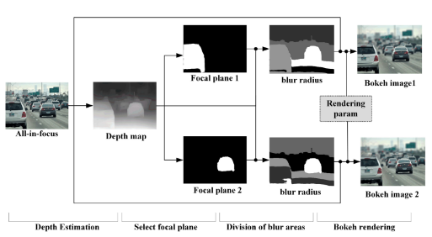
Literature works
Rendering Natural Bokeh Effects Based on Depth Estimation to Improve the Aesthetic Ability
Image Synthesis for data augmentation using Style-GAN
U-Net based architecture for depth estimation
K-means is used for clustering the depth range.
Gaussian blurring for points in a certain depth

Slide 4
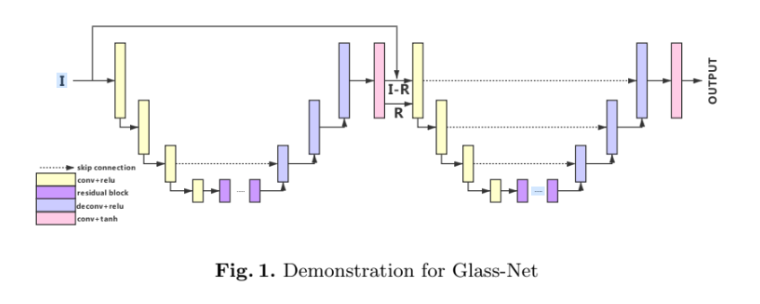
Literature works
BGGAN: Bokeh-Glass Generative Adversarial Network for Rendering Realistic Bokeh
In this paper a novel generator called GlassNet is proposed, Glassnet is an end to end generator which takes an image as input and produces an image with bokeh as output
As seen in the figure, the BG-GAN resembles Unet structure, here the first part translates image to rough bokeh images and second part refines bokeh effect, first stage and second stage have almost same structure
Encoder/decoder structure is adopted consisting of combination of upsampling/downsampling layers with skip connections

Slide 5
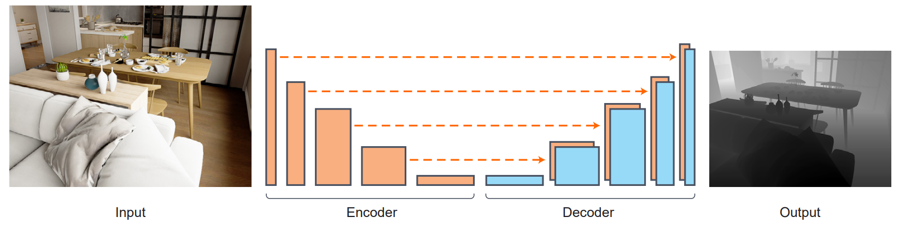
Methods – Depth estimation based bokeh
Encoder decoder based architecture is employed for depth estimation
Densenet-169 network pretrained on imagenet dataset is used as feature extractor
Decoder is made of a series of convolution and upsampling layers with skip connections which construct final depth map
Depth Estimation Architecture
Loss function:

Slide 6
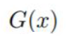
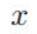
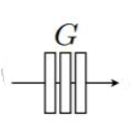
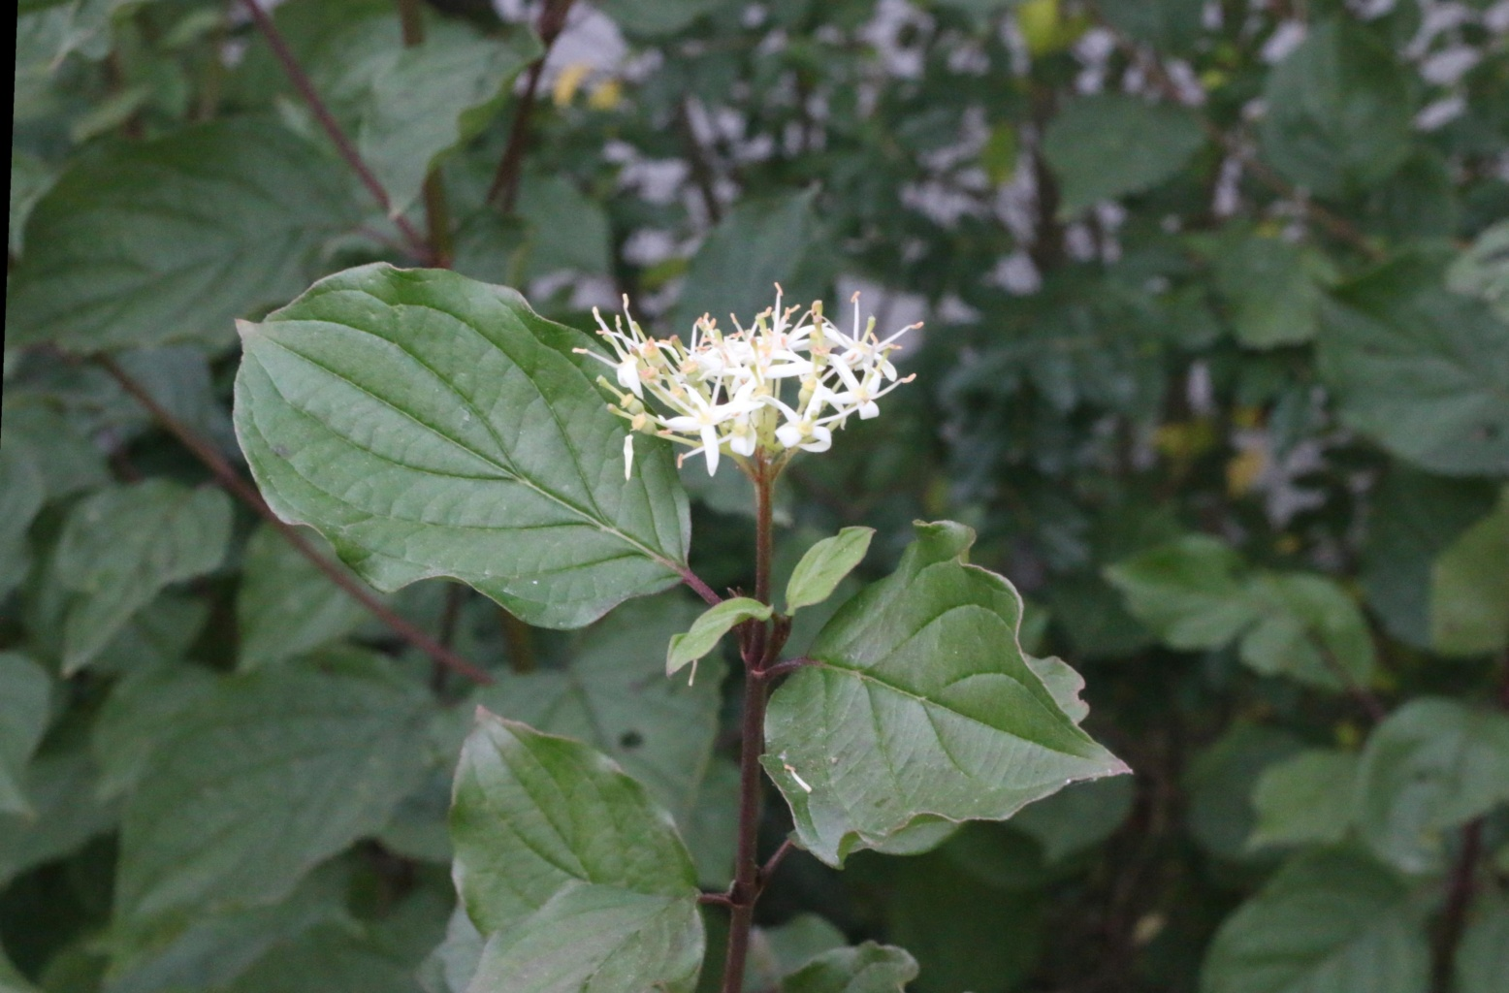
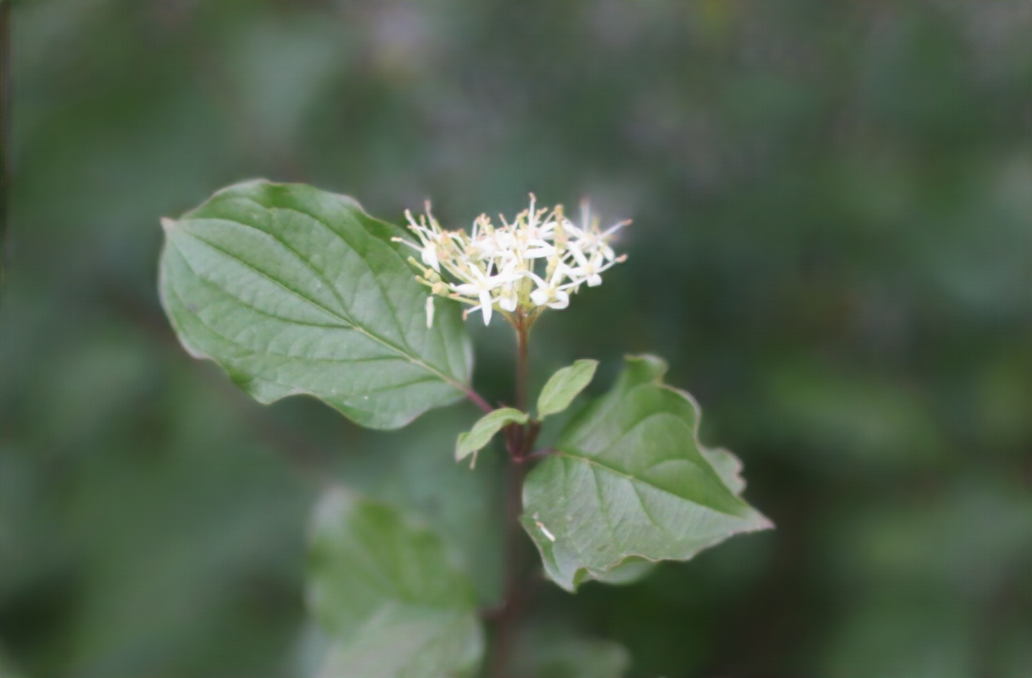
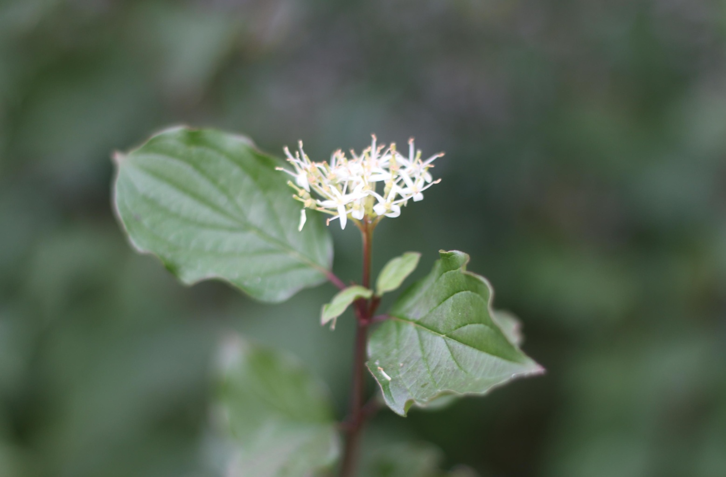
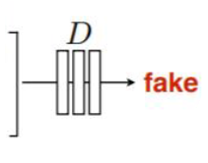
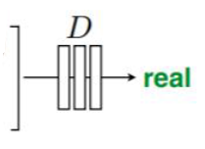
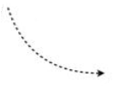
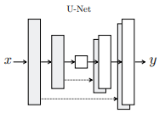
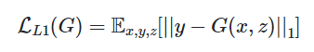
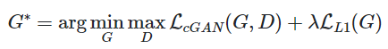
Methods – Generative modelling based bokeh
Pix2Pix: Training a conditional GAN to map Original image→Bokeh Image
Generator Architecture
GAN loss:
Generator based on Unet architecture
A discriminator represented by convolutional patch GAN classifier
Reconstruction loss:
Total loss:
Loss functions

Slide 7
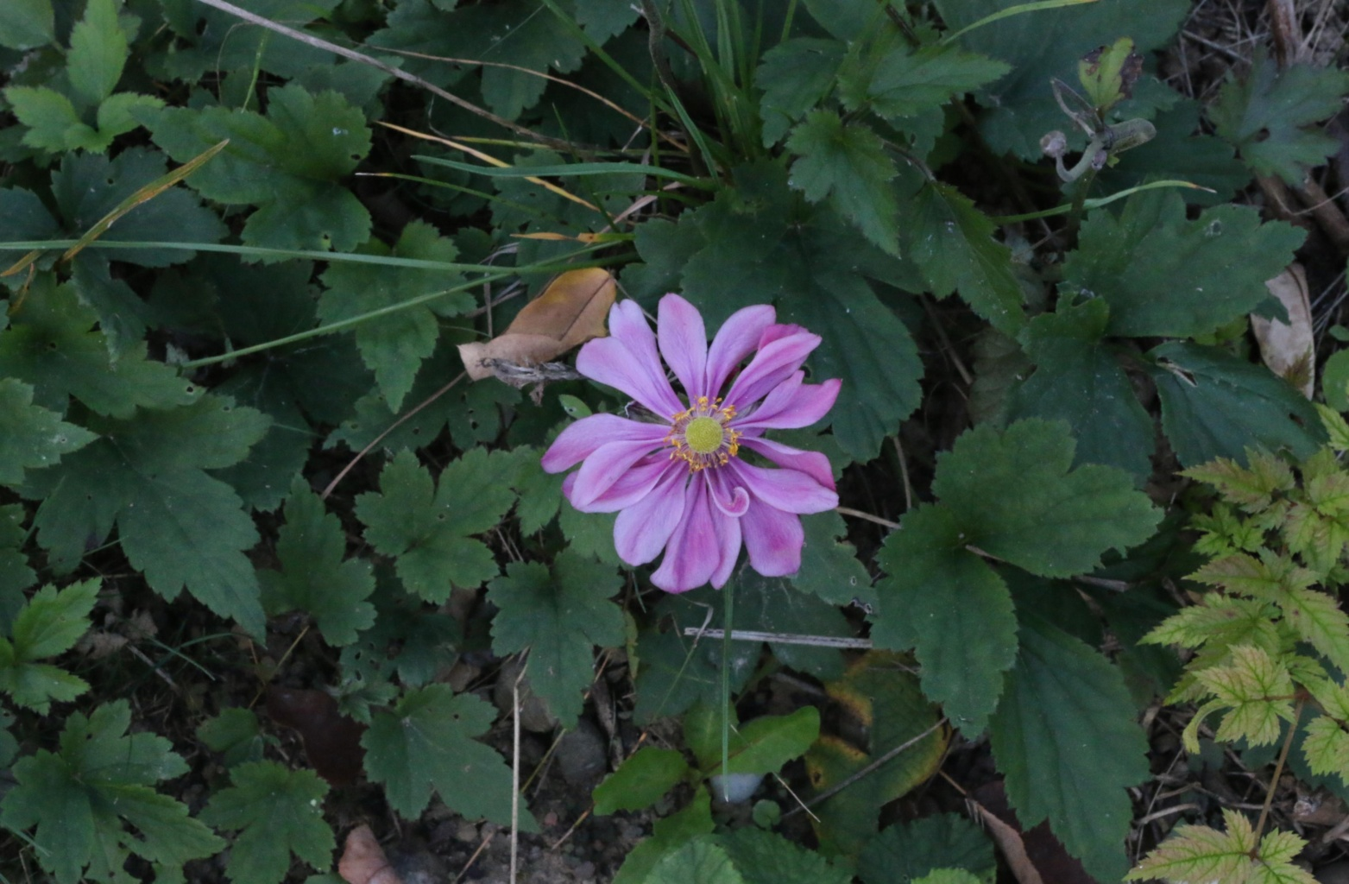
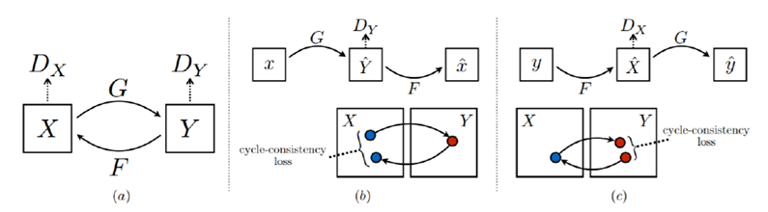

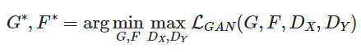
Methods – Generative modelling based bokeh
X: Original
Y: Bokeh
CycleGAN Training
CycleGAN learns a mapping from X to Y and Y to X
One to One mapping is ensured via cycle consistency loss
Reused similar generator and discriminator architecture as pix2pix
GAN loss G: X->y:
Cycle consistency loss:
Total loss:
Solve:
Loss functions

Slide 8
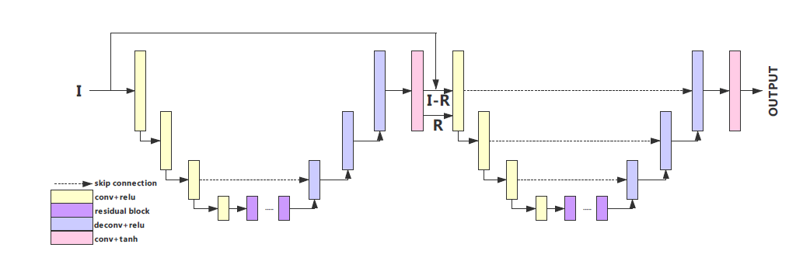
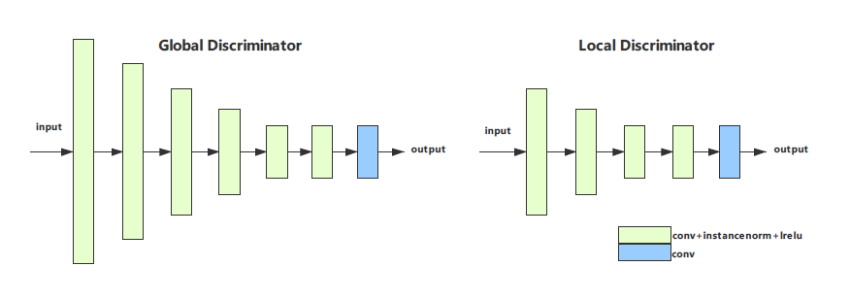
Methods – Generative modelling based bokeh
BG-GAN generator Architecture
BG-GAN Discriminator Architecture
Discriminator based on patchGAN
Generator inspired by Unet architecture
Re-Implemented Instance Normalization to work on smartphone GPU
Experimented on EBB dataset and they won AIM 2020 Bokeh Effect Rendering Challenge
Utilized BGGAN pretrained checkpoint and Evaluated PSNR and SSIM on the generated bokeh images to get exact estimates

Slide 9
Dataset details & Evaluation criteria
NYU Depth V2
The NYU-Depth V2 data set comprises of video sequences from a variety of indoor scenes as recorded by both the RGB and Depth cameras, it features:
1449 densely labeled pairs of aligned RGB and depth images
464 new scenes taken from 3 cities
EBB dataset: AIM 2020 Bokeh Effect Rendering Challenge.
The dataset consists of 4600 shallow/wide depth-of-field image pairs.
Bokeh Rendering: Qualitative evaluation
Image to image translation:
Peak signal-to-noise ratio (PSNR)
Structural Similarity(SSIM)
Download link: https://cs.nyu.edu/~silberman/datasets/nyudepthv2.html, EBB: register for AIM 2020 Bokeh Effect Rendering Challenge.

Slide 10
Experiments – Depth Estimation based bokeh
Depth estimation and post processing to add Gaussian blur based on depth map
Trained on NYU dataset and obtained depth map
Applied Gaussian blur on depth map based on threshold values 0.2, 0.25, 0.3
Evaluated the trained model on EBB dataset and calculated PSNR and SSIM on bokeh ground truth and generated bokeh images
Used Unet based model for depth estimation and not generative modelling because based on literature survey it was found that encoder/decoder based architecture works best for depth estimation
Method | Threshold | PSNR | SSIM
Depth Estimation + Gaussian blur on depth map | 0.2 | 29.086 | 0.805
 | 0.25 | 29.106 | 0.790
 | 0.3 | 29.127 | 0.775

Slide 11
Experiments – Generative modelling based bokeh
Employed conditional Adversarial training to perform direct image to image translation to generate bokeh images from original images
Trained Pix2Pix generative model on EBB dataset
Created a dataset of a pair of images based on original image and its bokeh version
Build the unet style based generator model and Build patch GAN based discriminator model for 70x70 patch size
Trained discriminator, generator alternatively based on the loss functions given in method section
Generated bokeh images based on trained model and evaluated PSNR and SSIM
Employed model check-pointing for progressive training of the model
Trained CycleGAN generative model on EBB dataset
Employed similar architecture of generator and discriminator as in pix2pix

Slide 12
Experiments – Generative modelling based bokeh
Trained CycleGAN generative model on EBB dataset(continued)
Datasets for original and bokeh images created separately
Trained generator and discriminator for original to bokeh and also trained one more generator and discriminator for bokeh to original based on loss functions as given in method slide
Generated bokeh images based on original during inference and evaluated PSNR and SSIM based on ground truth and generated images
Employed model checkpointing for progressive training
Evaluate pre-trained BGGAN model
Utilized pre-trained BGGAN and evaluated PSNR and SSIM
Method | PSNR | SSIM
BGGAN | 30.967 | 0.897
CycleGAN | 21.545 | 0.741
Pix2Pix | 16.743 | 0.441

Slide 13
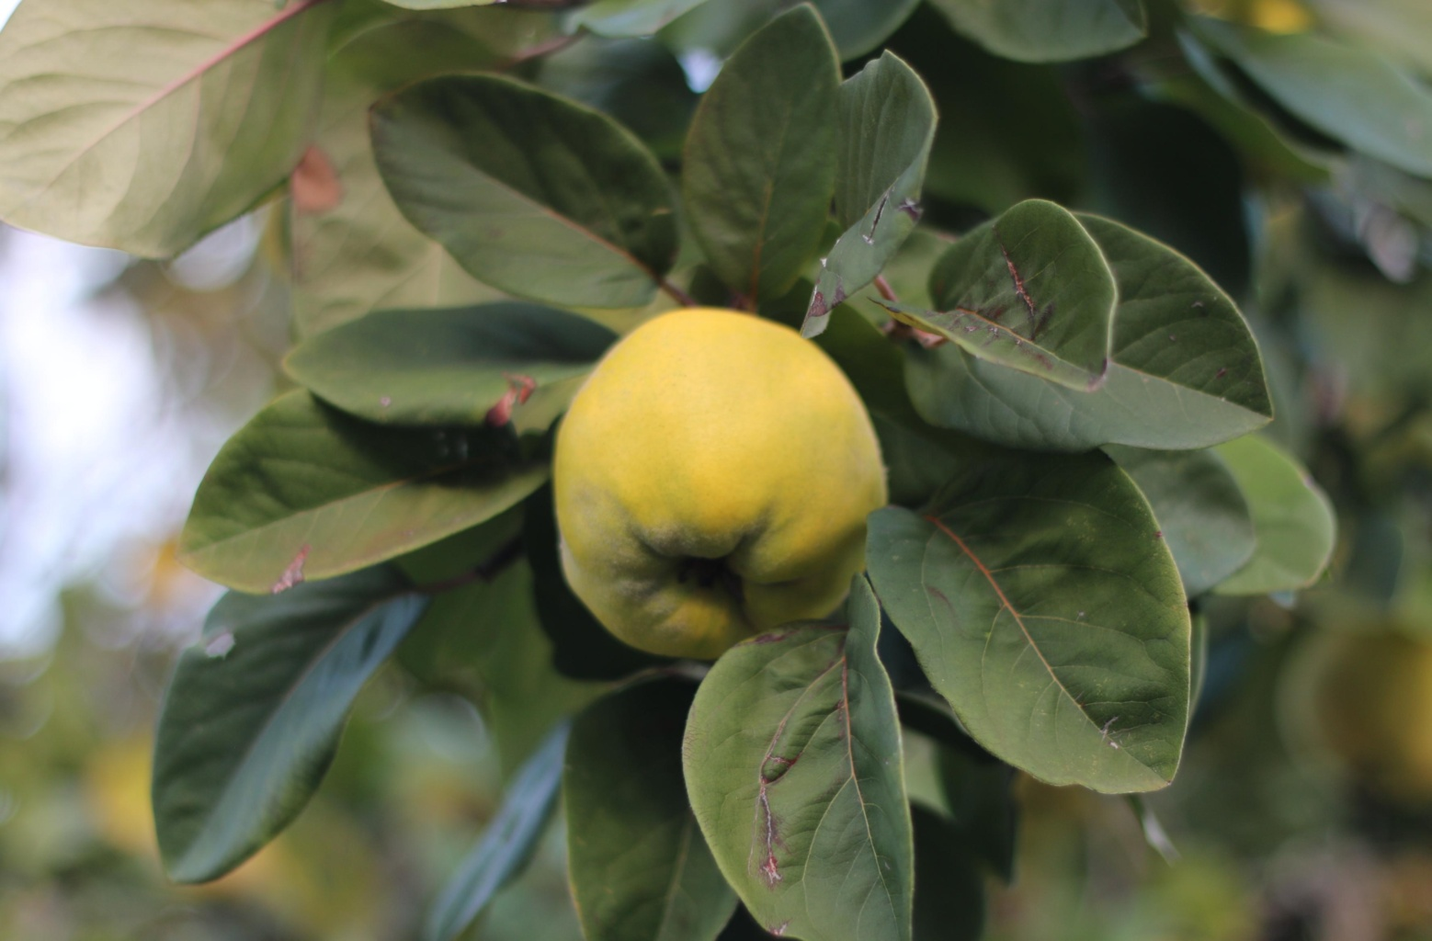
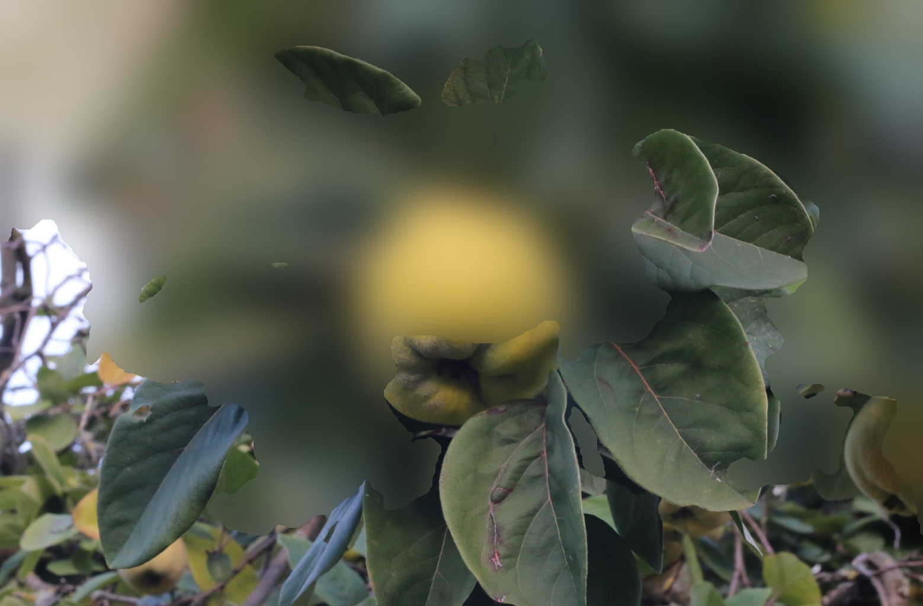
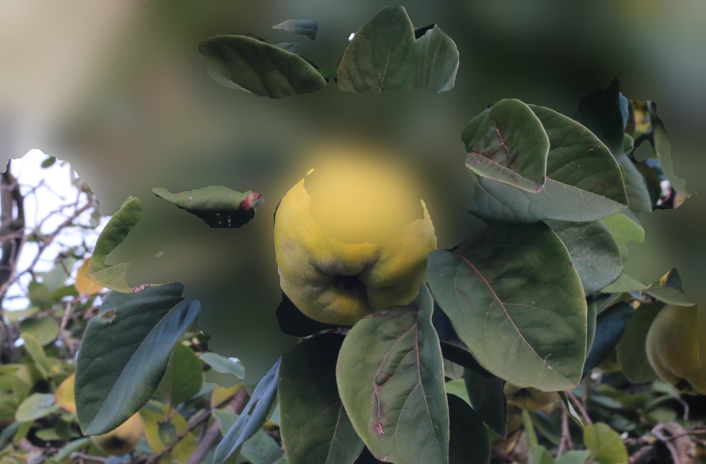
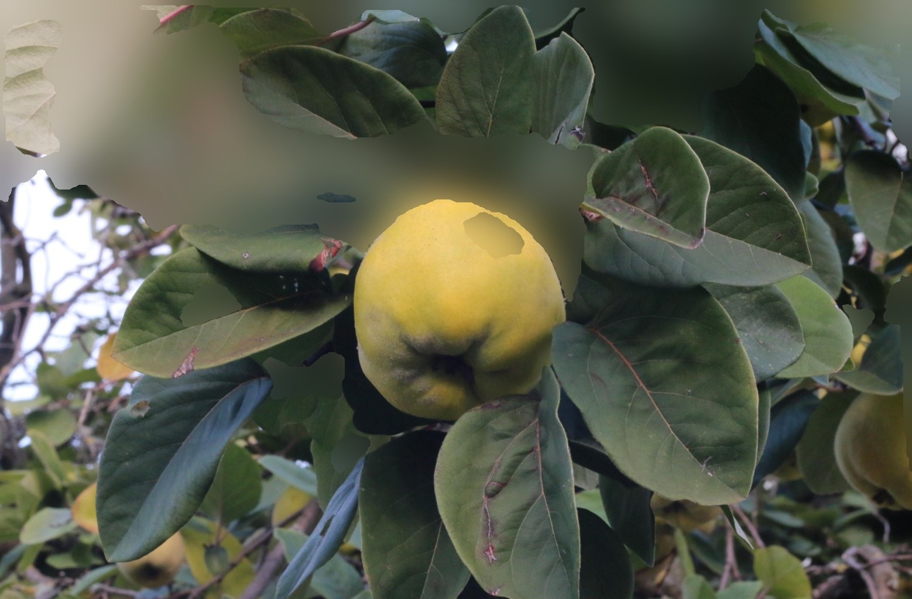
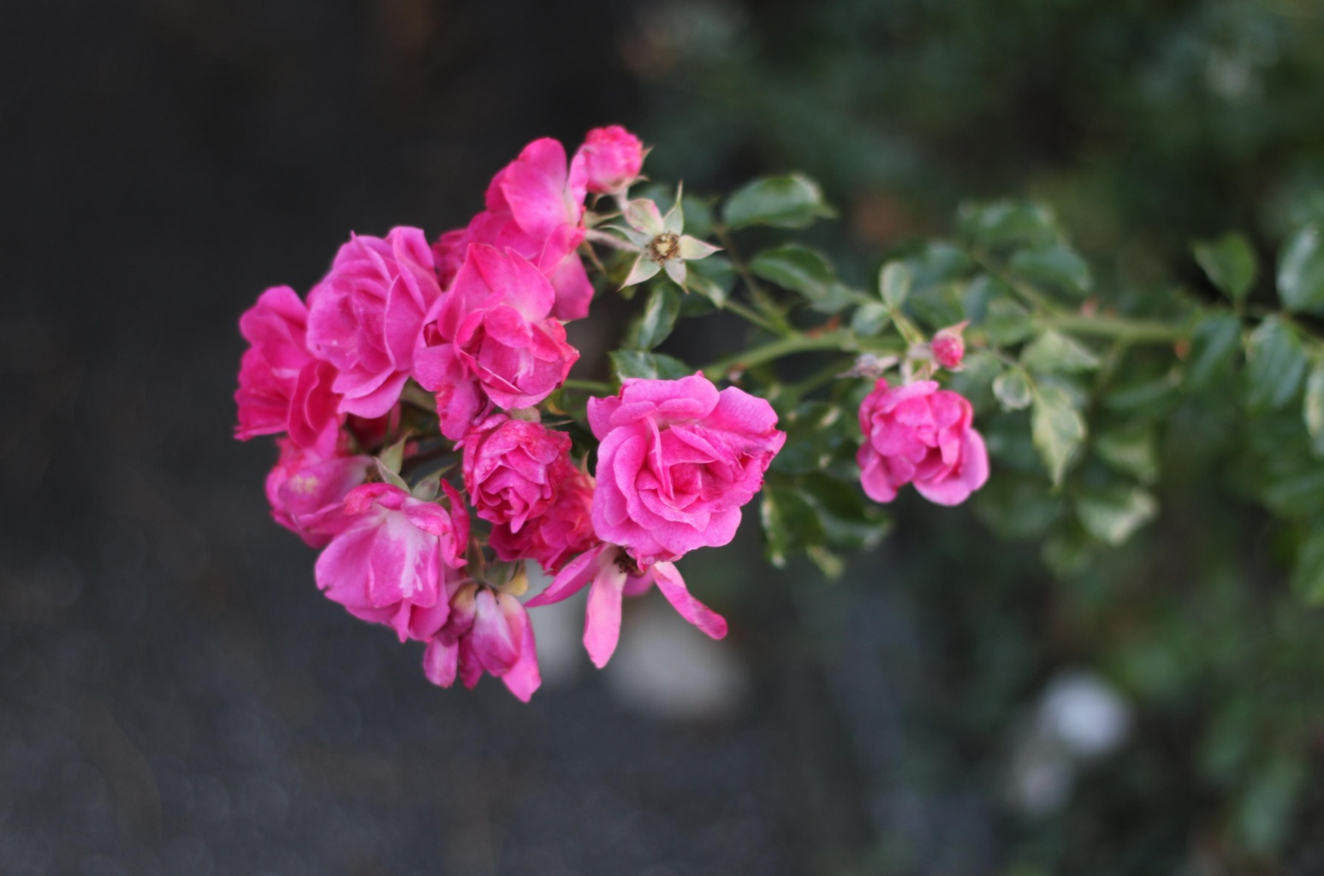

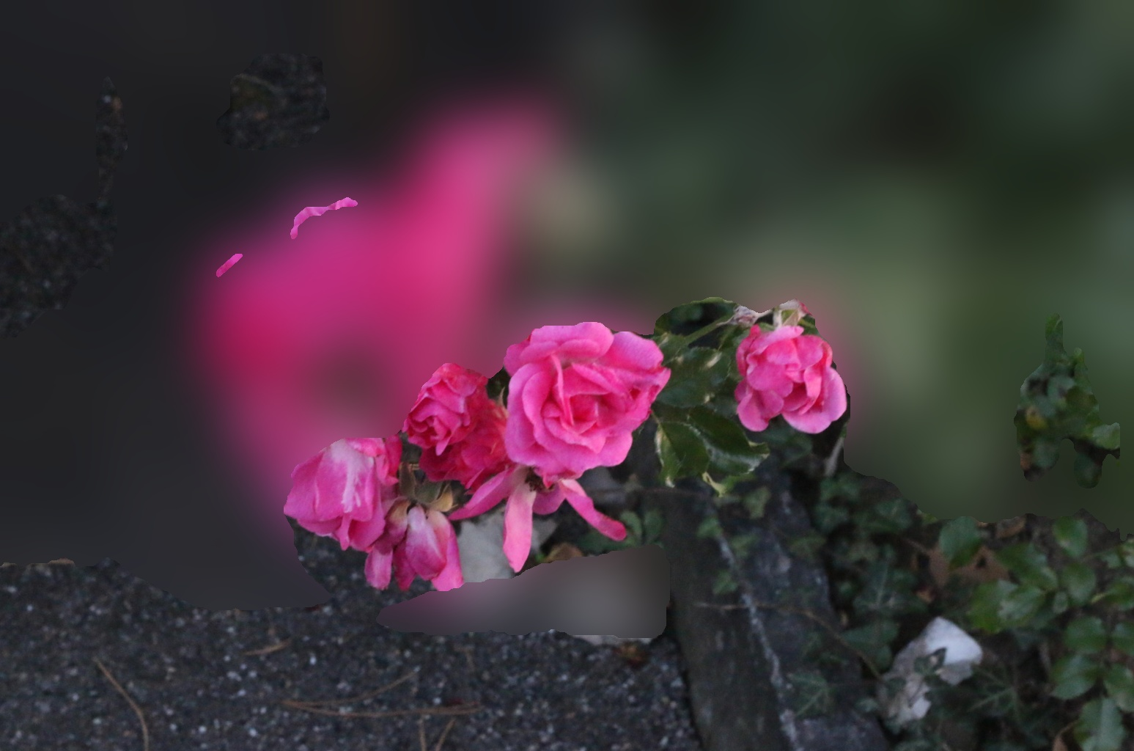
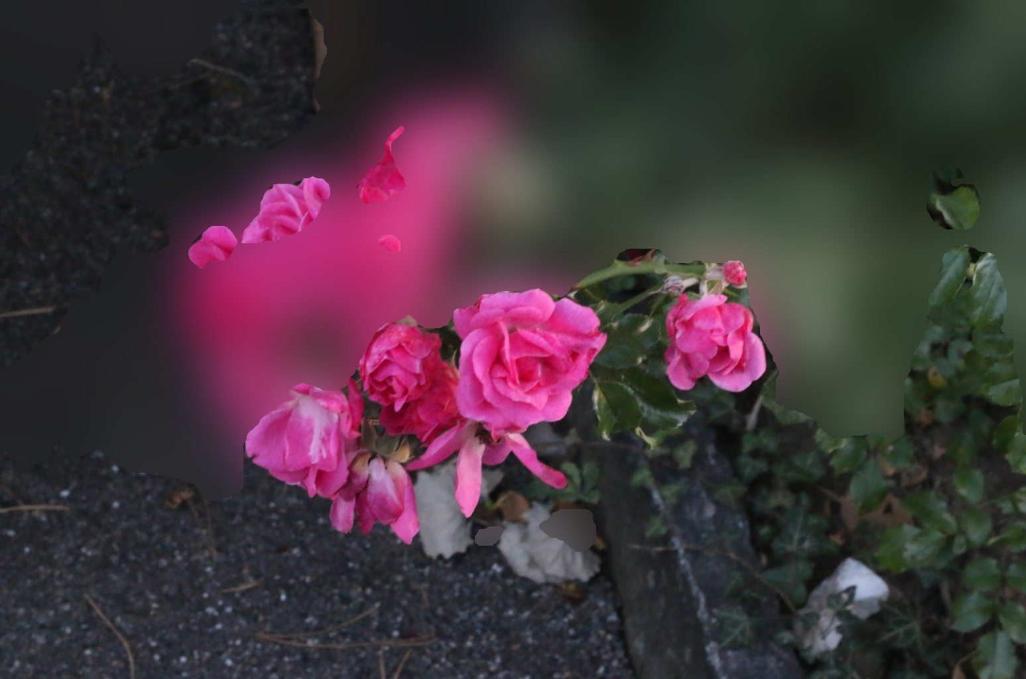
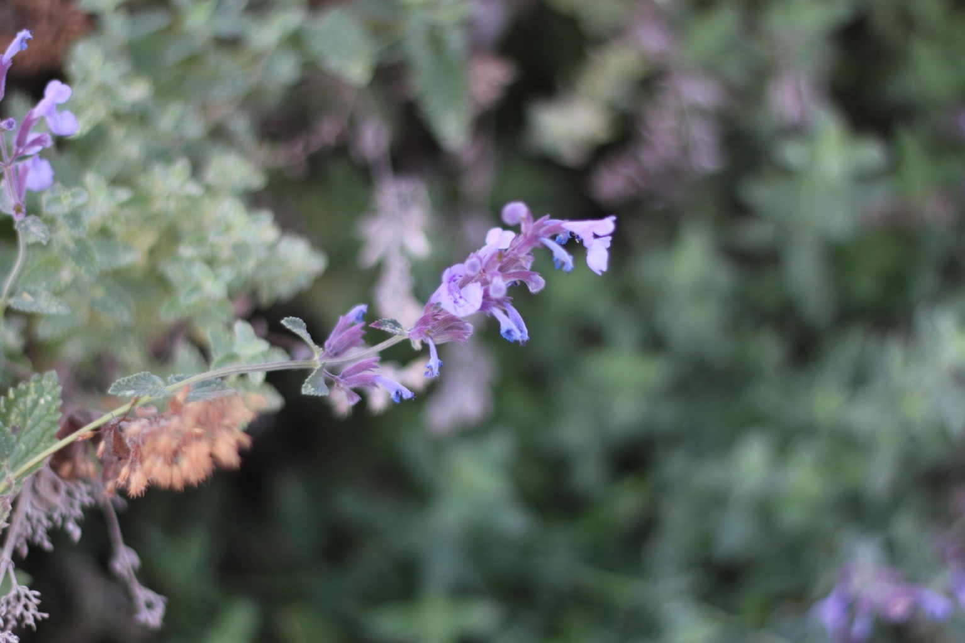
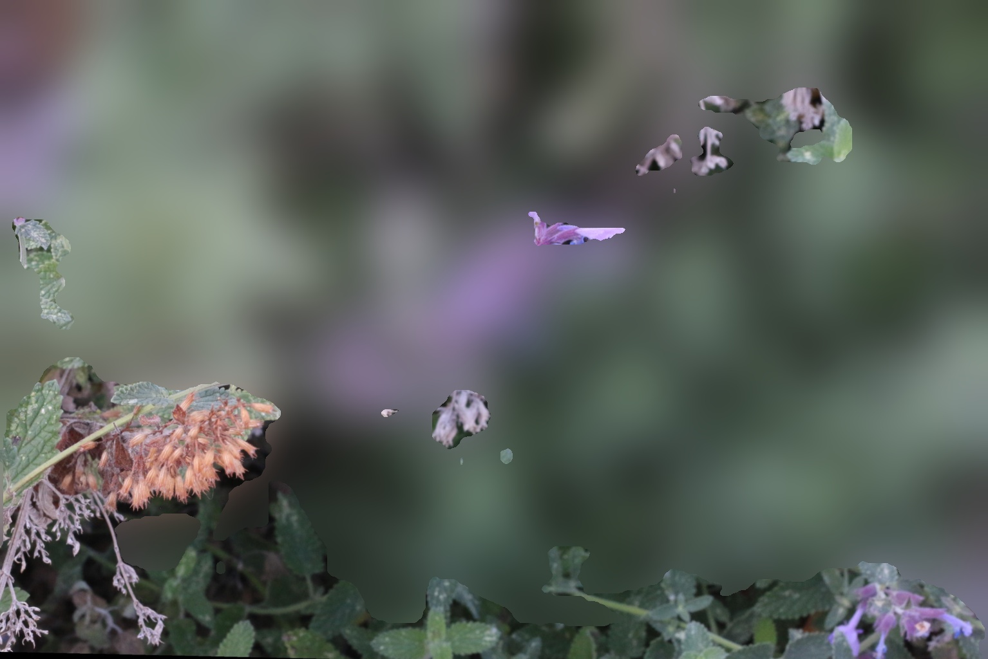
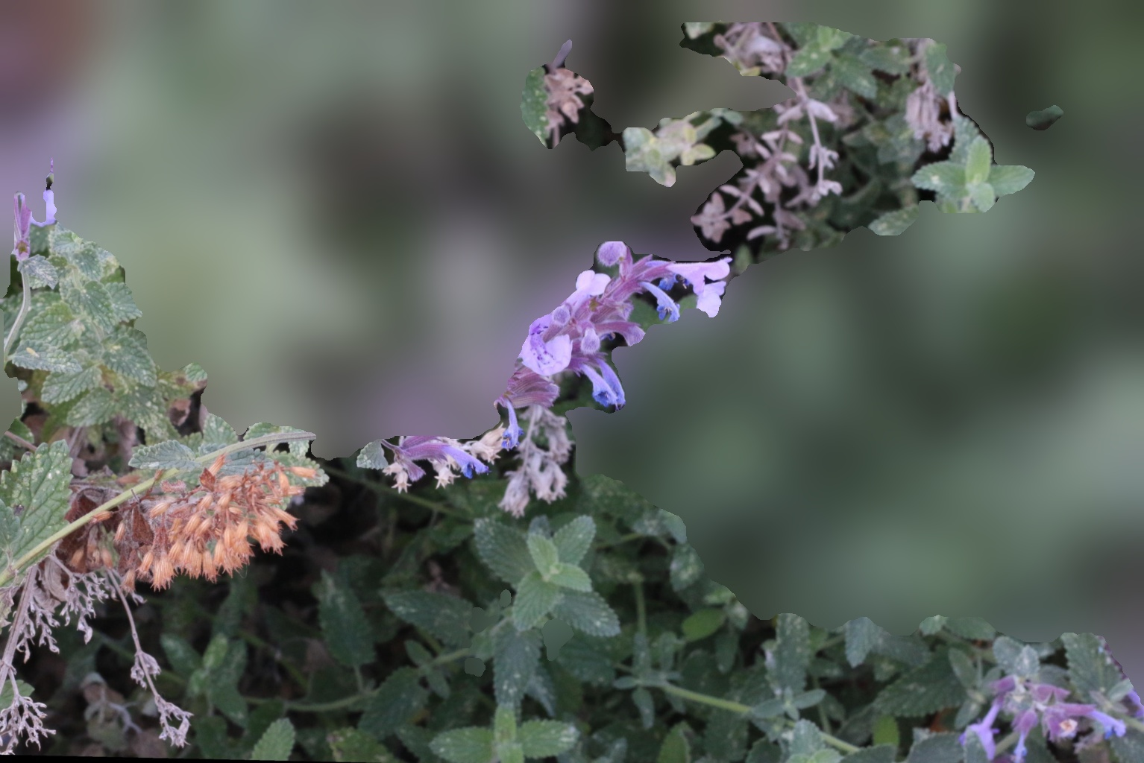
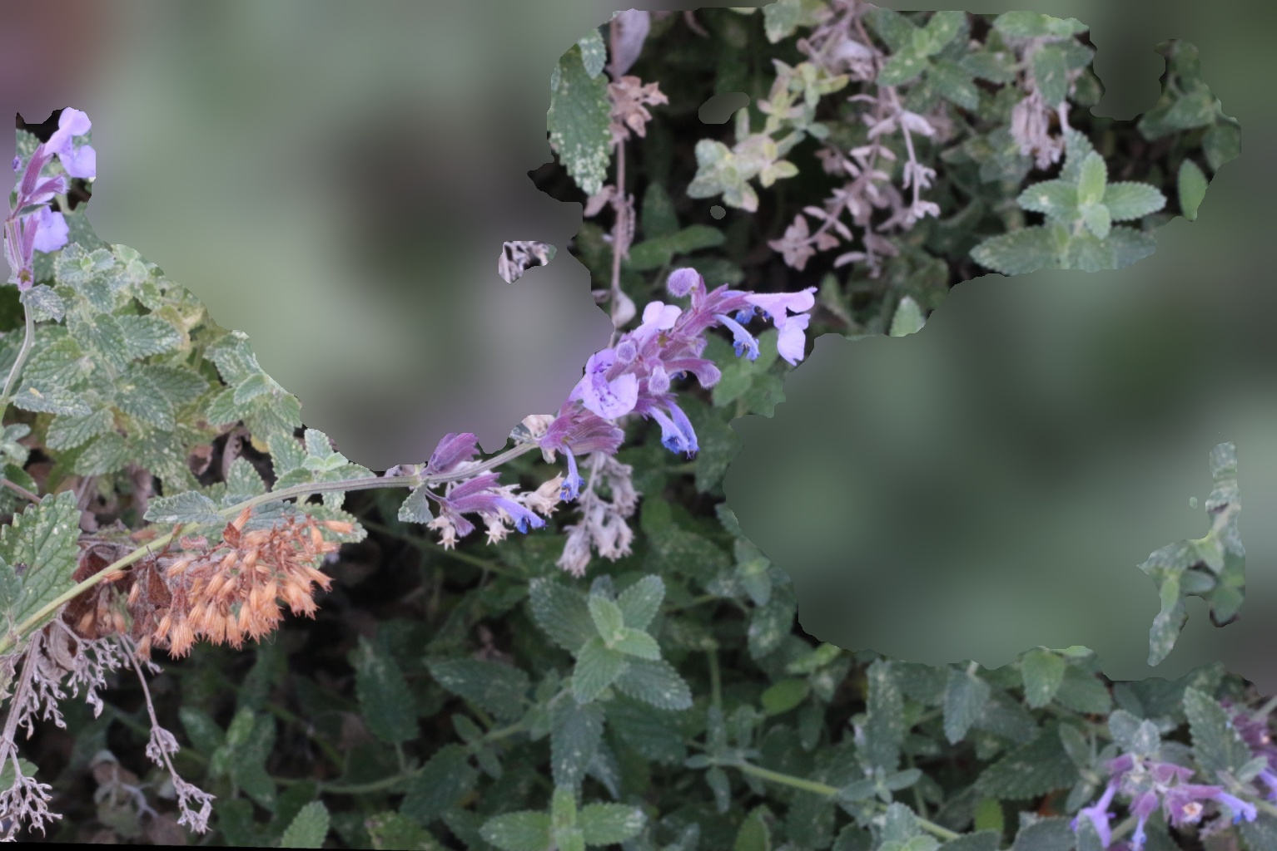
Qualitative evaluation – Depth Estimation based bokeh
Ground Truth | Depth Estimation(0.2) | Depth Estimation(0.25) | Depth Estimation(0.30)

Slide 14
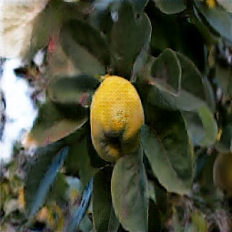
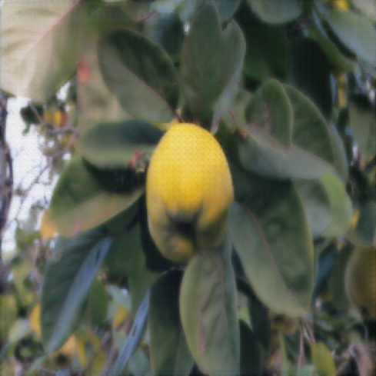
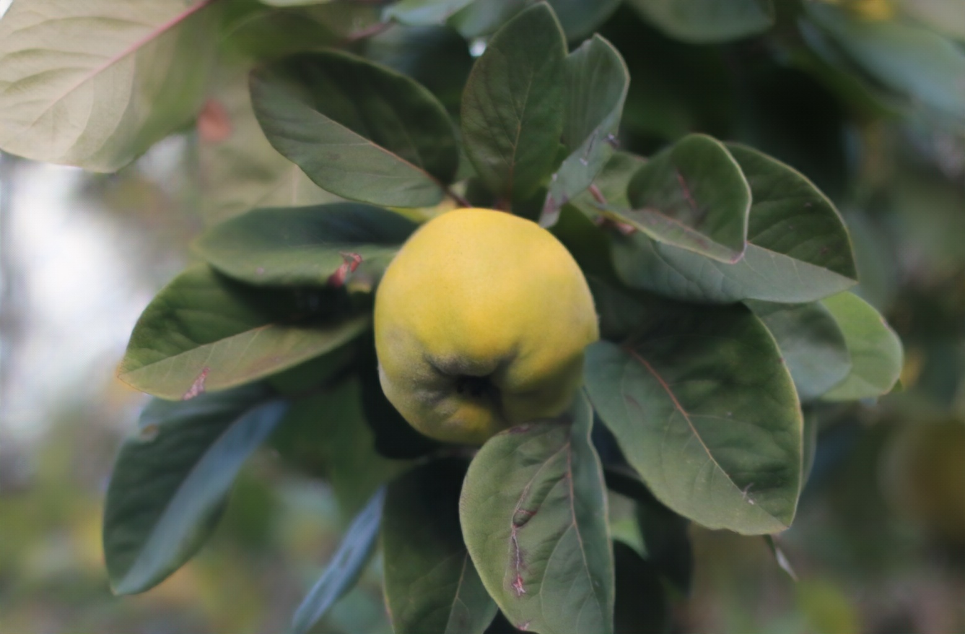
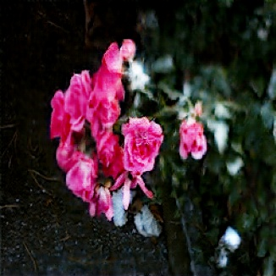
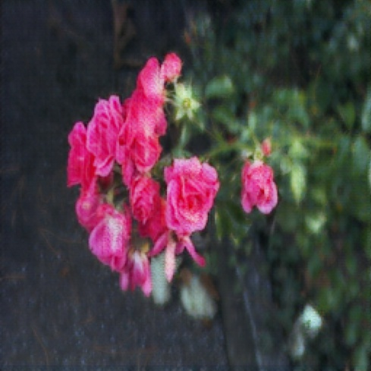
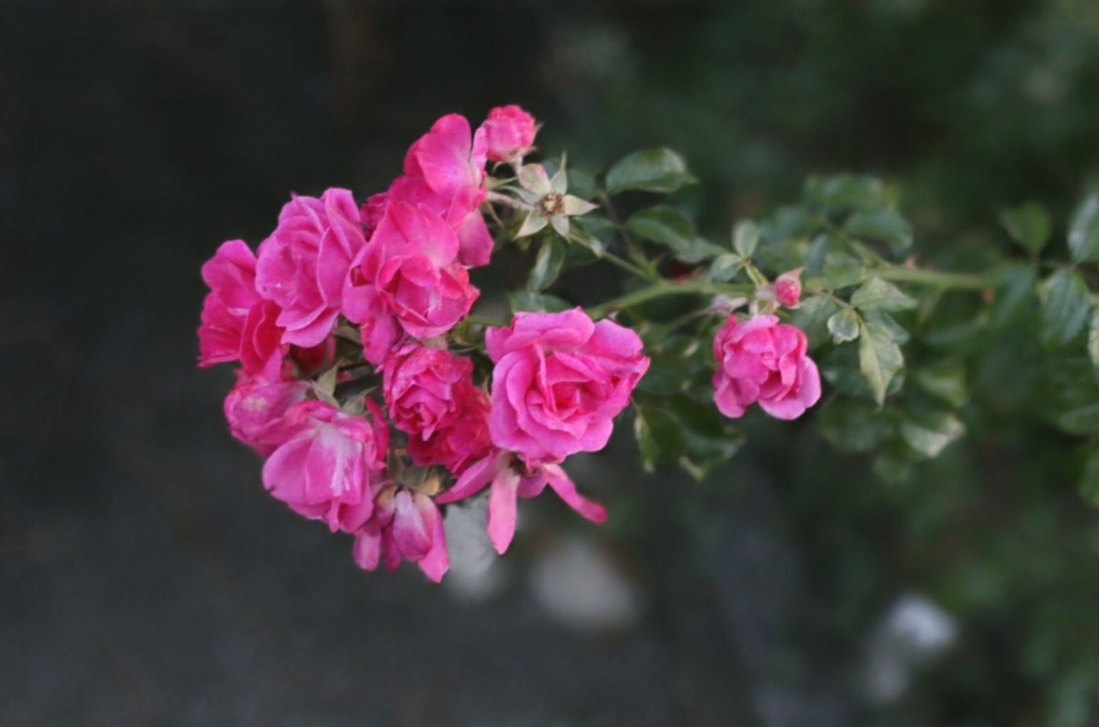
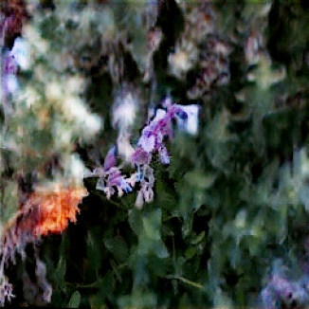
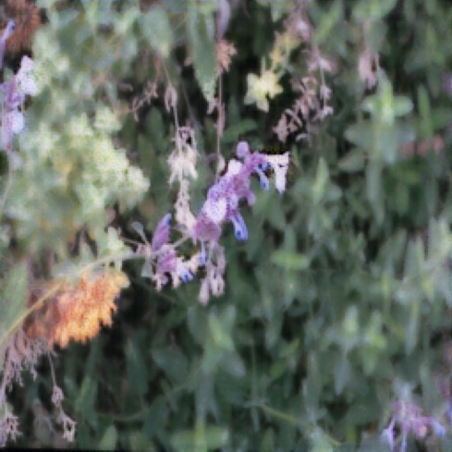
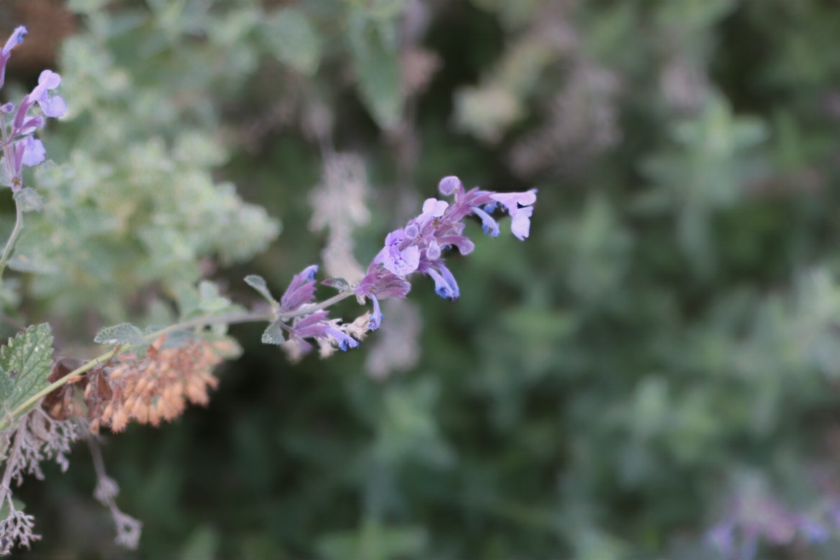
Qualitative evaluation – Generative modeling based bokeh
Ground Truth | Pix2Pix | CycleGAN | BGGAN
14

Slide 15
Results and future work
Method | PSNR | SSIM
Depth Estimation + bokeh(0.2) | 29.086 | 0.805
Depth Estimation + bokeh(0.25) | 29.106 | 0.790
Depth Estimation+ bokeh(0.3) | 29.127 | 0.775
BGGAN | 30.967 | 0.897
CycleGAN | 21.545 | 0.741
Pix2Pix | 16.743 | 0.441
Continue experimentation with more complex encoder /decoder architecture as part of generator for image translation models and train for longer hours using a GPU which would help in improving the metrics PSNR and SSIM
Integrate Depth map in to the GAN models to improve bokeh prediction results
Experiment using style GAN by giving a bokeh image as a style (+other DSLR properties) and compare with cycleGAN and pix2pix results

Slide 16
References
[1] On the Benefit of Adversarial Training for Monocular Depth Estimation
https://arxiv.org/pdf/1910.13340.pdf
[2] Rendering Natural Bokeh Effects Based on Depth Estimation to Improve the Aesthetic Ability
https://www.mdpi.com/2075-1702/10/5/286/pdf
[3] Rendering Natural Camera Bokeh Effect with Deep Learning
https://arxiv.org/pdf/2006.05698.pdf
[4] Image-to-Image Translation with Conditional Adversarial Networks
https://arxiv.org/pdf/1611.07004.pdf
[5] Unpaired Image-to-Image Translation using Cycle-Consistent Adversarial Networks
https://arxiv.org/pdf/1703.10593.pdf
[6] Stacked Deep Multi-Scale Hierarchical Network for Fast Bokeh Effect Rendering from a Single
Image
https://ieeexplore.ieee.org/document/9522800
[7] BGGAN: Bokeh-Glass Generative Adversarial Network for Rendering Realistic Bokeh |
https://arxiv.org/pdf/2011.02242.pdf
[8] High Quality Monocular Depth Estimation via Transfer Learning
https://arxiv.org/pdf/1812.11941.pdf

Slide 17
Questions?
Thank you!!

